Slide 1


Planning a Career in Cybersecurity
Joe Cicero
Director of Strategic Alliances
https://github.com/joecicero/careercoaching

Slide 2








Mapping A Career in Cybersecurity
Why?
How do you get in?
Is it your passion?
So what?

Slide 3

"Security is, I would say, our top priority because for all the exciting things you will be able to do with computers—organizing your lives, staying in touch with people, being creative—if we don't solve these security problems, then people will hold back.“ — Bill Gates, 2002, Microsoft
…People were not held back, and the problems have grown exponentially…

Slide 4





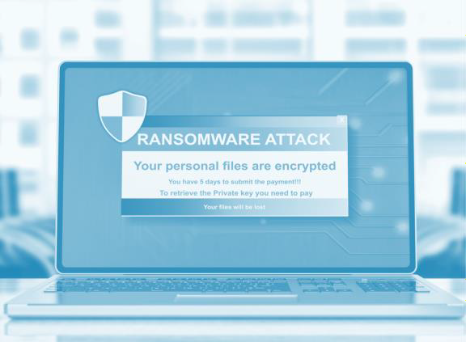


State of Cybersecurity
Threats are evolving
Number of threat actors are growing
Security products and services are not perfect
Cybersecurity is a never-ending race
How can you join the mission?

Slide 5




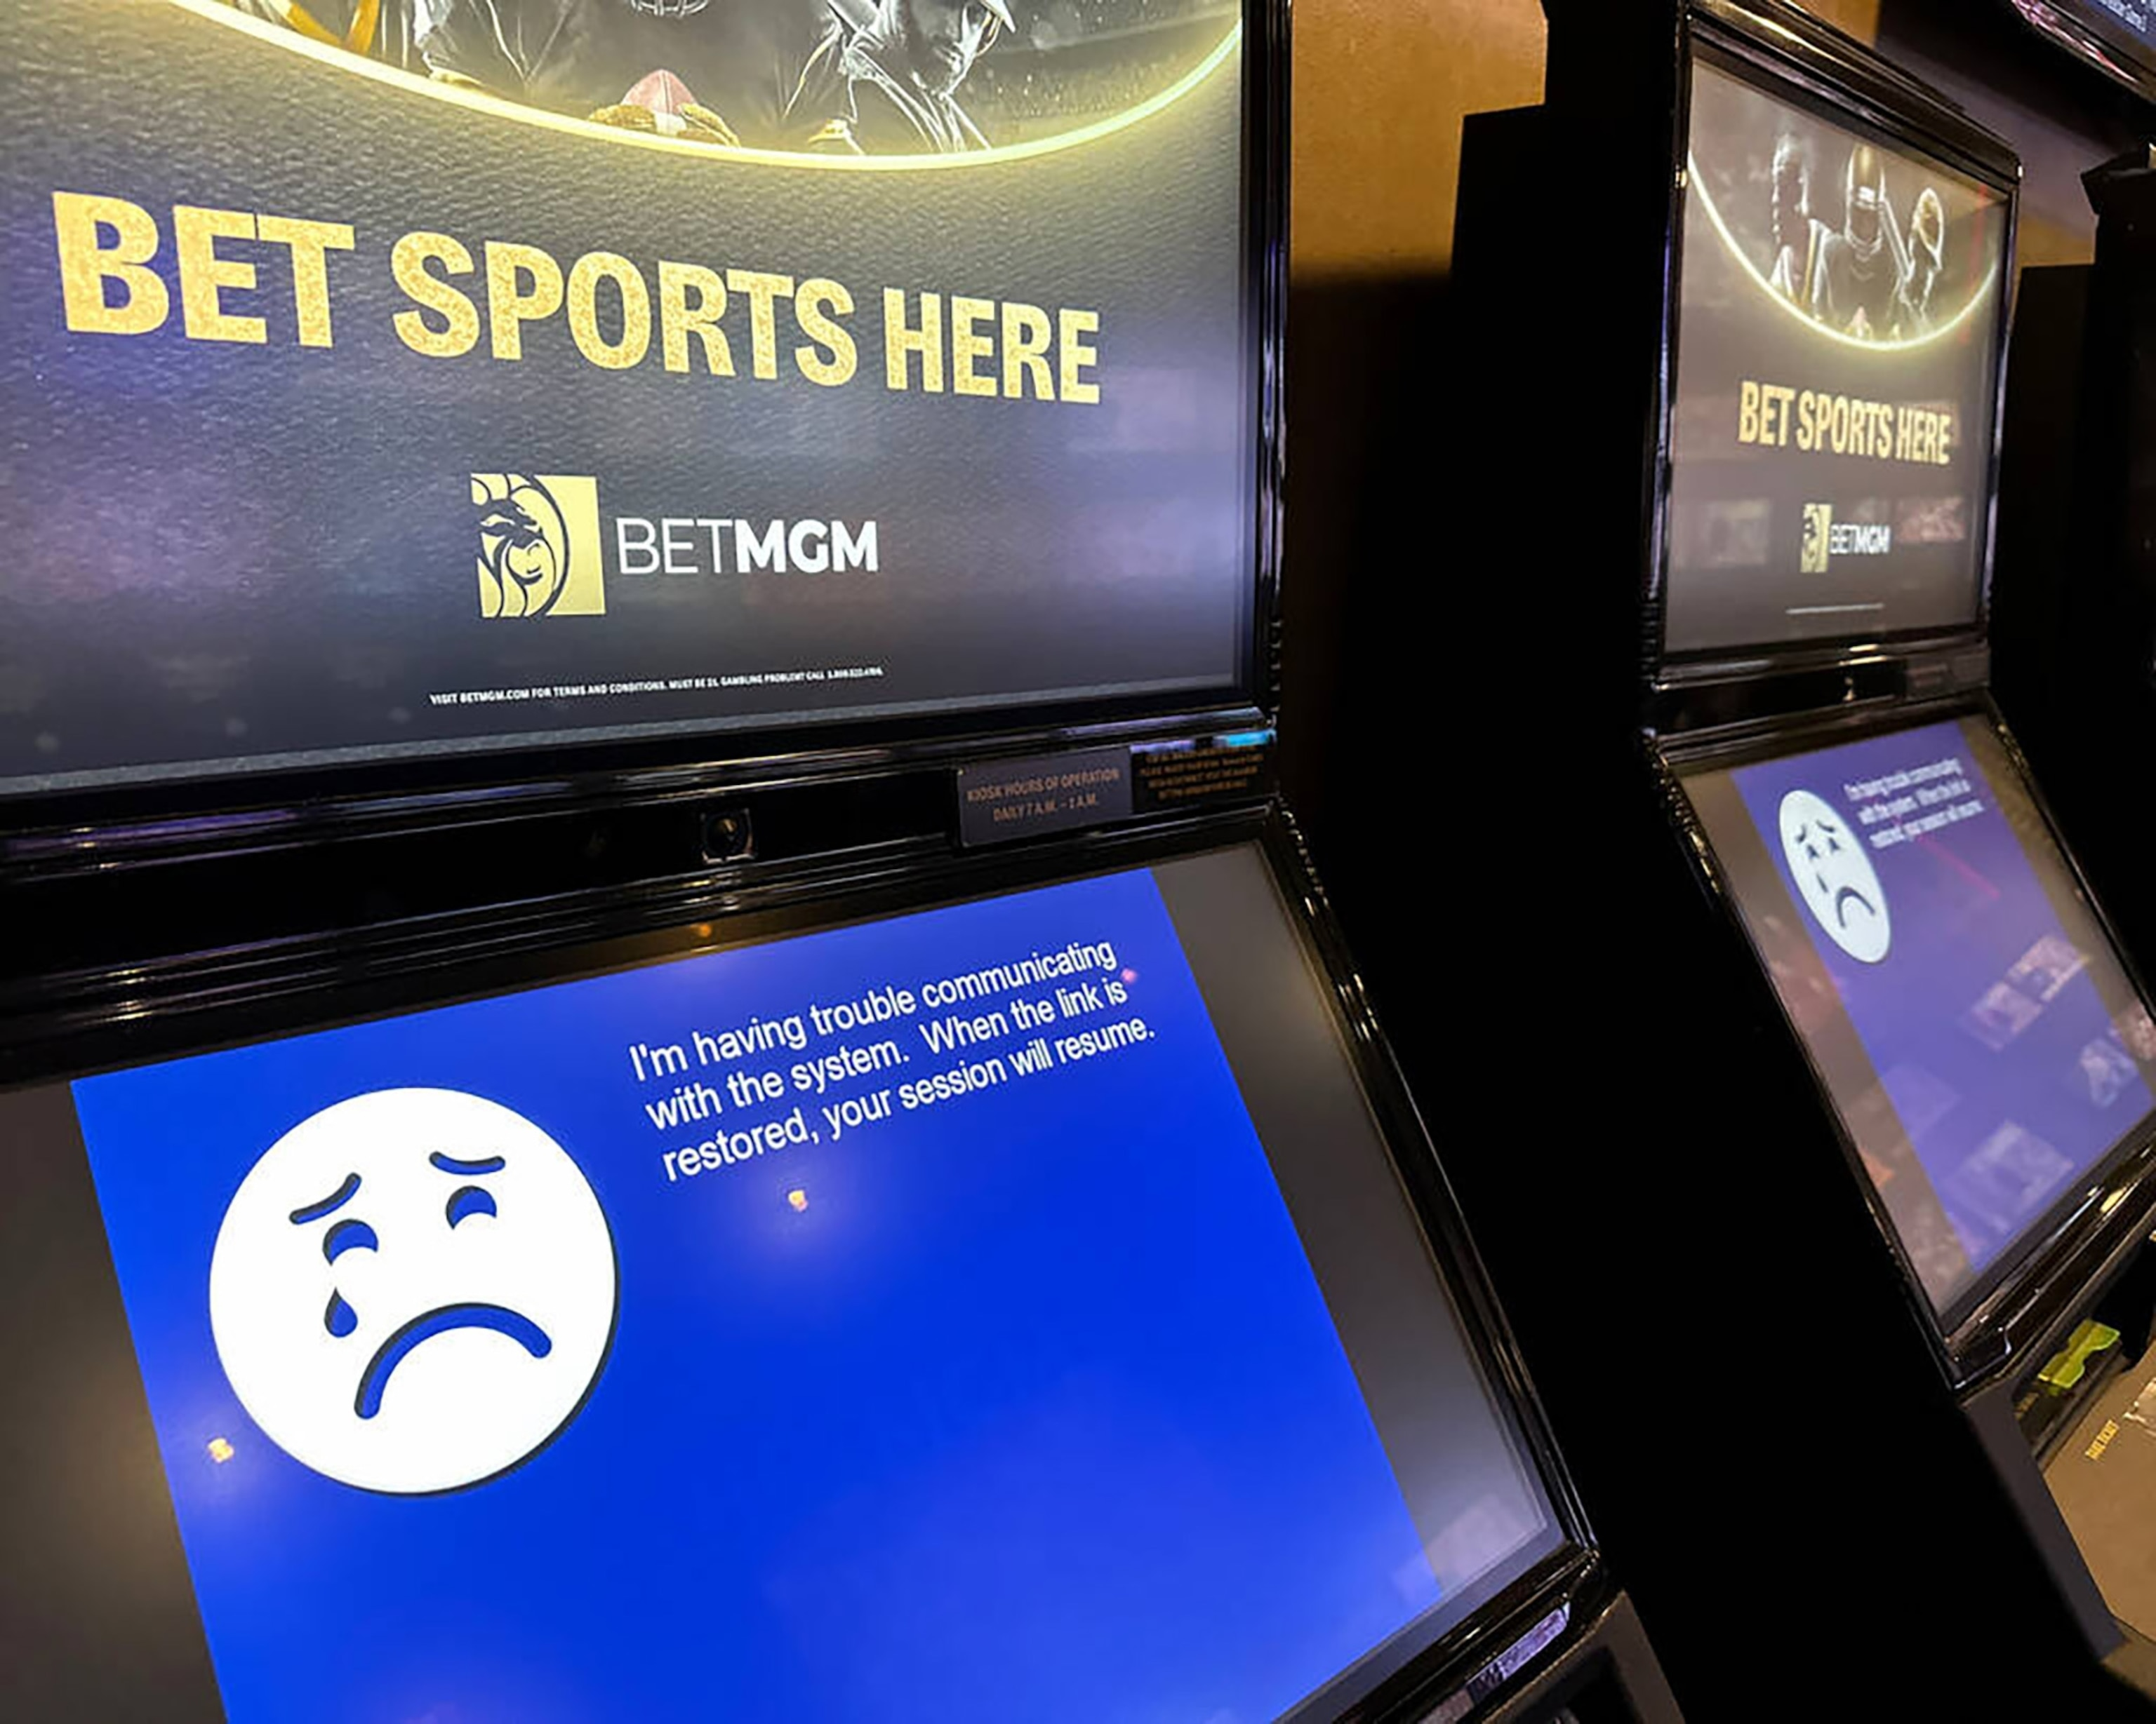
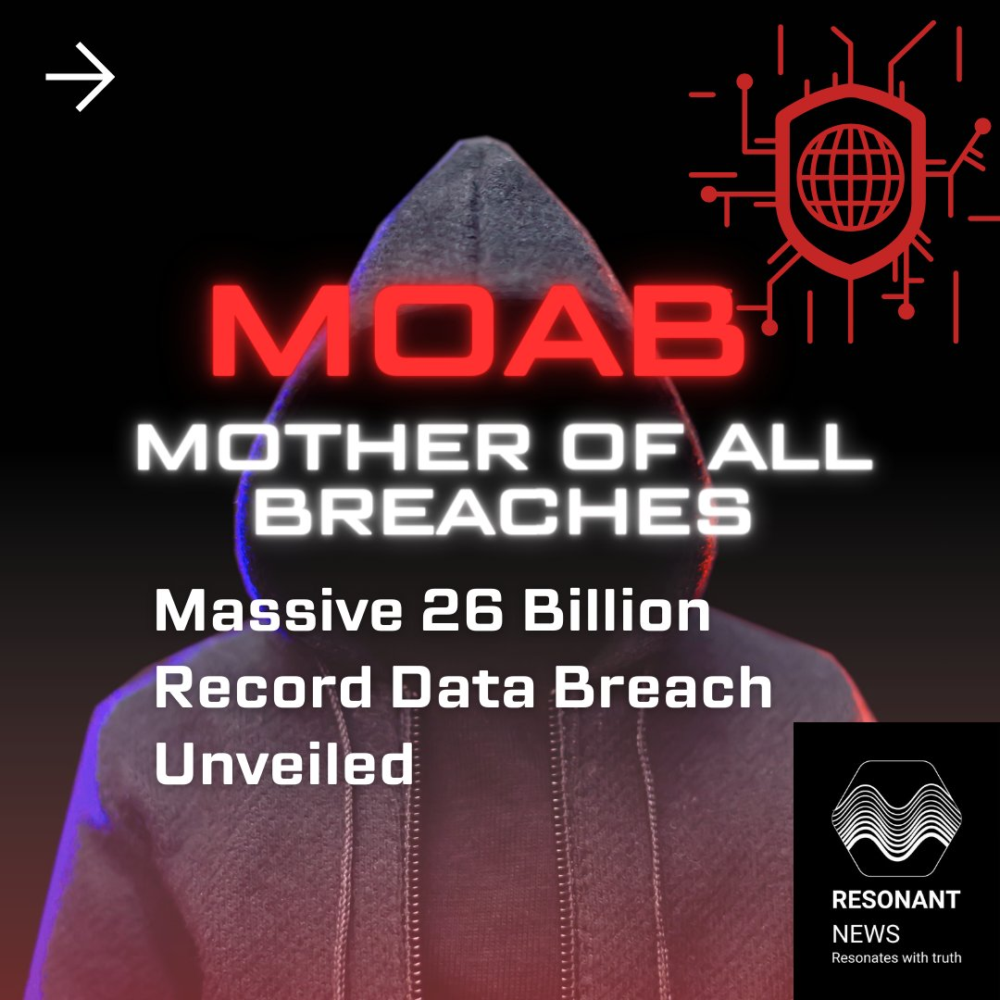
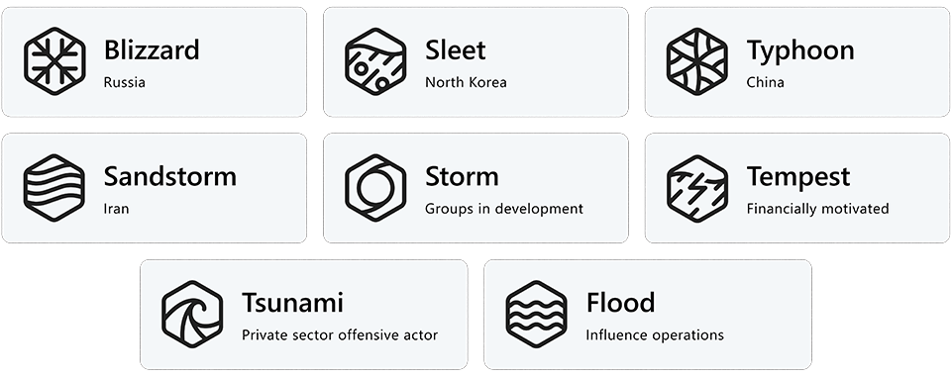
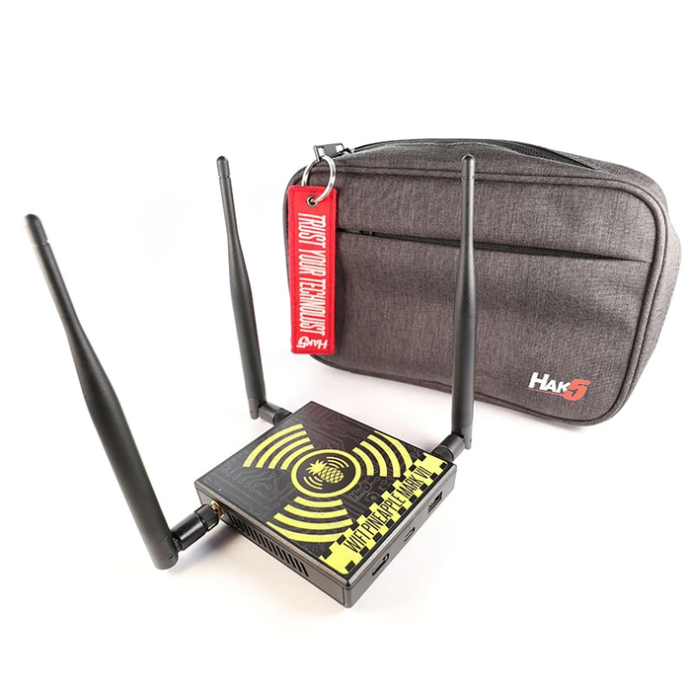

Why is Cybersecurity exciting?
Gadgets
News stories
Or Maybe the cool threat actor names?
Octo Tempest
Peach Sandstorm
Onyx Sleet
Microsoft Naming Conventions:

Slide 6
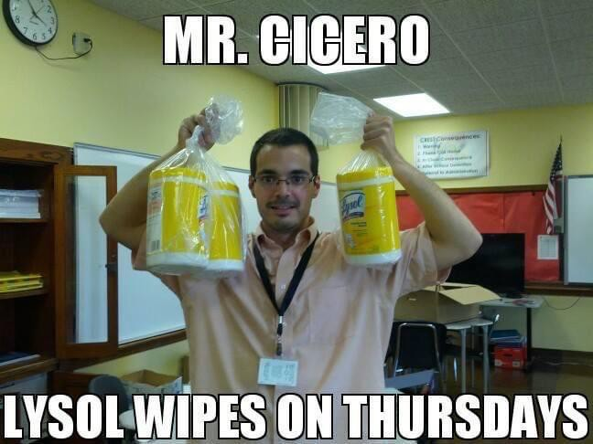
What does this high school teacher know about Cybersecurity
!?!?!?!?!?!?!?!?!

Slide 7
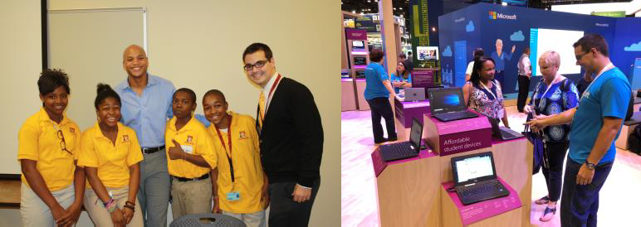
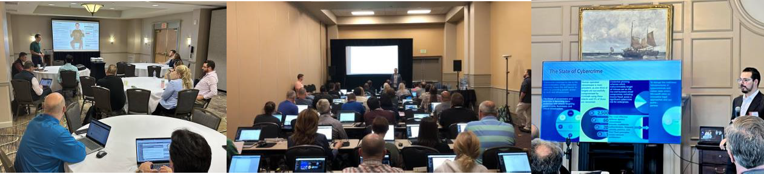
My Journey
AP World History Teacher @Rochester City School District
Technology Specialist @Rochester City School District
Edtech Consultant/Trainer/Deployment @Eduscape
Technical Seller - Window EDU @Microsoft
Program Manager – EDU Partner Ecosystem @Microsoft
Product Manager – Defender Experts @Microsoft
Service Delivery Manager @Microsoft
Director of Strategic Alliances @SRA

Slide 8







What We Do
RED
PURPLE
BLUE
SOC & XDR
SOLUTIONS
Objective-based Red Teams and TIBER
Pen Testing
Continuous Testing
AppSec, Cloud, Device & IoT
Threat Resilience Peer Benchmark Programs
VECTR™ SaaS
MITRE ATT&CK Alignment
Detection Improvement
SIEM and Security Data Lake
Vuln Management
Strategy and tool deployments
Table-Top Exercises
PCI, HIPAA, HICP
Microsoft Specialization
Monitoring & Response
Threat Intel and Hunts
SIEM & EDR Tuning
Incident Response & Forensics
VECTR™ (vectr.io)
SIFTR™ (siftr.sra.io)
SCALR™ XDR (scalr.sra.io)
SCALR™ Sight (scalr.sra.io/sight)
(vectr.io)
(siftr.sra.io)
(scalr.sra.io)
(scalr.sra.io/sight)
CONSULTING
OPERATIONS
PLATFORMS
IT
OT
Cloud
AI
Helping you protect your business, your people, and your customers.
Notes:
Option: bold services you are presenting to client

Slide 9

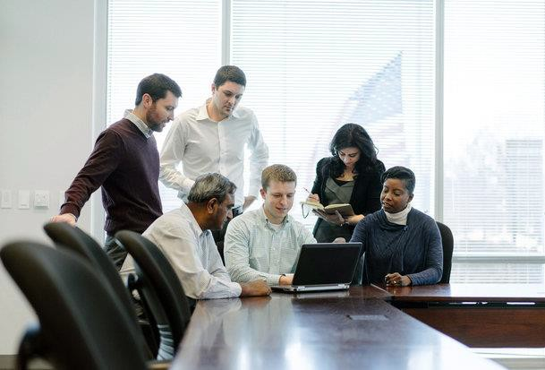
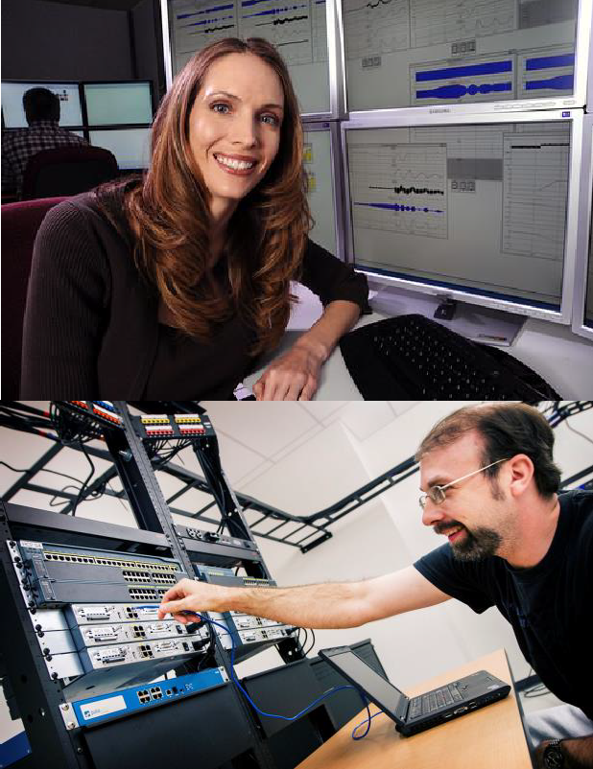
What is your goal?
Analyst: Protects computer networks from cyber attacks by monitoring, investigating, and fixing security issues.
pen-tester: Simulates attacks to test the security of computer systems, networks, applications and databases.
threat-hunter: Proactively finds and stops advanced cyber threats that may evade security systems.
AI innovator: Creates new AI models, algorithms, tools or frameworks for cyber defense, threat detection, incident response, risk assessment or vulnerability analysis.
Service Delivery Manager: Manages the relationships with external security vendors and partners and monitors the performance and quality of the security services delivered to the clients.

Slide 10
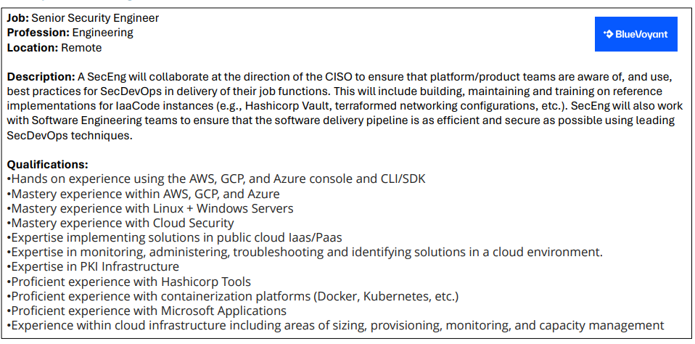


Example Job #1

Slide 11
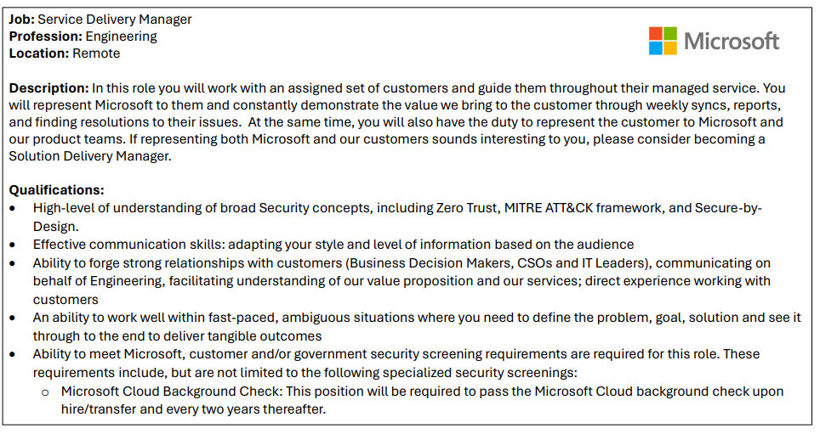

Example Job #2

Slide 12

Example Job #3
Job: Cybersecurity Operations (CSOC) Consultant
Profession: Security Operations/Analyst
Location: Remote
Description: The Cybersecurity Operations Consultant position will be part of Security Risk Advisors’ CyberSOC team. This role will be involved in the day-to-day, 24x7, operations of the SOC. This is an outstanding opportunity to work with a wide variety of tool sets and various client organizations.
Qualifications:
Eyes on glass security monitoring for threats.
Respond to alerts, investigate to determine if they are true positive or false positive.
Use the latest security monitoring technologies to detect malware and hackers.
Use Security Information Event Management tools (SIEM), Endpoint Detection & Response tools (EDR), and Network Security Monitoring tools (NSM) such as FireEye, Fidelis, Splunk, Intel/McAfee, RSA, IBM, Symantec, Resilient, Cybereason, Tanium, CarbonBlack, Bro and Snort.
Thoroughly document work and present findings to management suitable for customer consumption.
Attend conferences and training as required to maintain proficiency.
Protect organization's value by keeping information confidential.
Ability to work non-core hours, including weekends and night shifts.

Slide 13
Example Job #4
Job: Offensive Security Senior Consultant
Profession: Offensive Security / Pen-tester
Location: Rochester, NY
Description: The Offensive Security Senior Consultant position will be part of our Advisory practice on the Technical Assessments team. Our style of consulting is dynamic, innovative, fast-paced, and highly rewarding for both our clients and our team. This is an outstanding opportunity to work with a wide variety of tool sets and across various well-known client organizations.
Qualifications:
Flexibility to accommodate changing schedules of client and project needs and willingness to work extended hours when needed.
Demonstrable aptitude for technical writing, including assessment reports, presentations, and operating procedures.
Experience communicating with clients and independently managing client projects.
Knowledge of Windows and *NIX-based operating systems.
Knowledge of networking fundamentals and common attacks/defenses.
Experience managing multiple projects at once.
Strong analytical skills with the ability to collect, organize, analyze, and disseminate significant amounts of information with attention to detail and accuracy.
Strong written/verbal communication and interpersonal skills.
Excellent technical skills, impeccable soft skills, and organization skills.
Strong written and verbal communication skills to effectively communicate successes and obstacles with team members and leads, as well as client stakeholders.

Slide 14
How do we grow?
Knowing the industry and options
Understanding our transferable experience
Setting a goal and/or target
Determining gaps
Creating action plan
Determining Next Steps
-
=
Skills & Knowledge Needed
Transferable Knowledge & Skills
Skills gap/Learning Opportunity
Determining knowledge and skills needed
Determine what resources and experiences are available
Creating a timeline to match required skills
Starting

Slide 15
Beginning your Journey
News
Product Agnostic Learning
Product Learning/Certifications
Microsoft Security Blog
SANS White Papers
Google Security Blog
Cybernews
The Hacker News
UDEMY: Cyber Security Course for Beginners - Level 01
Coursera: Introduction to Cyber Attacks
Pluralsight: The Information Security Big Picture (Free Trial)
Cybrary: Cybersecurity Foundations
edX: Cybersecurity
Microsoft Security
Palo Alto Networks
AWS Security
Crowdstrike
Google
Local Communities
Product Agnostic Certifications
Learning Labs
ISC2 Chapters
Cloud Security Aliance (CSA) Chapters
Information Systems Security
Association
Rochester ISSA
CompTIA Security+
GIAC
CISSP
CISA
CISM
Hack the Box
Try Hack Me
Pentester Lab

Slide 16
Creating Your Network
Regional Conferences
LinkedIn Groups
Find Local Bsides
BSidesROC - Saturday March 23, 2024
Bsides Buffalo – June 2024
Regional Black Hat Events
SecTor – Black Hat
Canadian Cybersecurity Network
Cyber Security
CyberSecurity Community
LinkedIn Contacts
Mike Pinch
Joe Cicero (me)
Tim Wainwright
Mona Ghadiri @ Blue Voyant
Ed Martin @ Microsoft
Michael Melone @ Microsoft
Abhishek Agrawal @ Microsoft
Cordell BaanHofman @Red Canary
National Conferences
Black Hat
Blue Hat
Def Con
RSA Conference

Slide 17

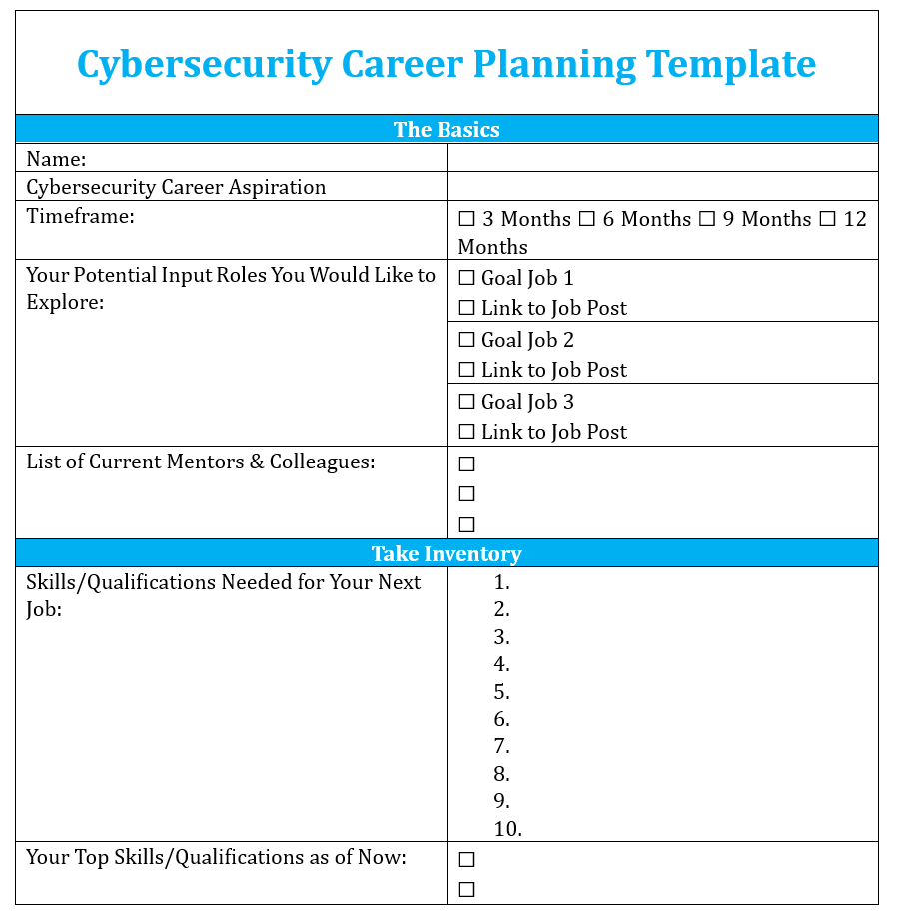
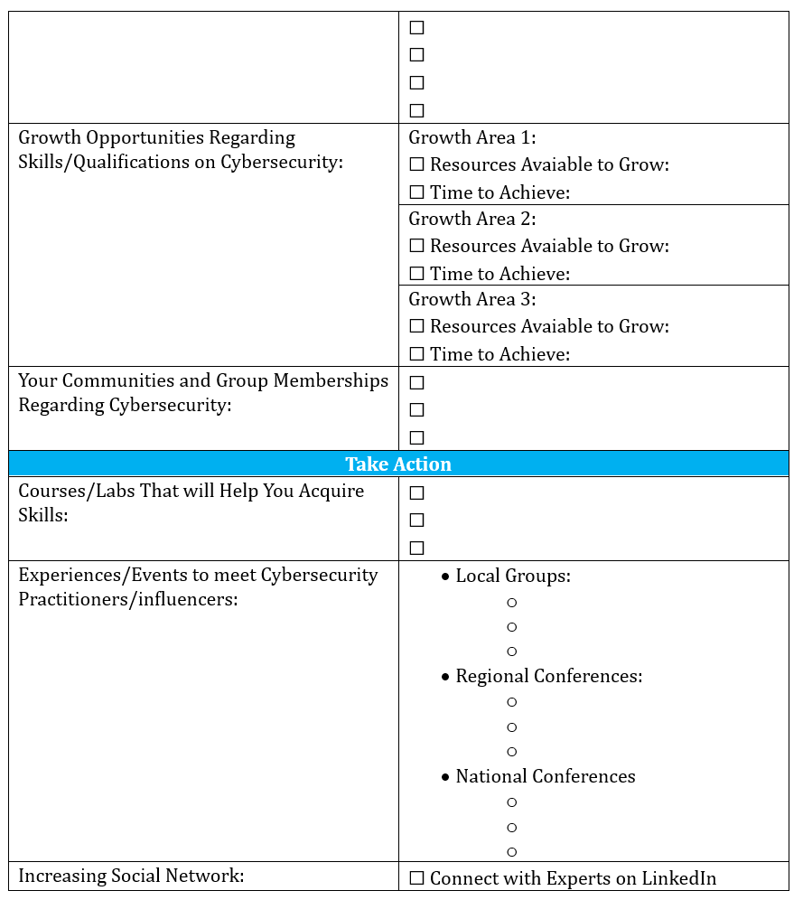
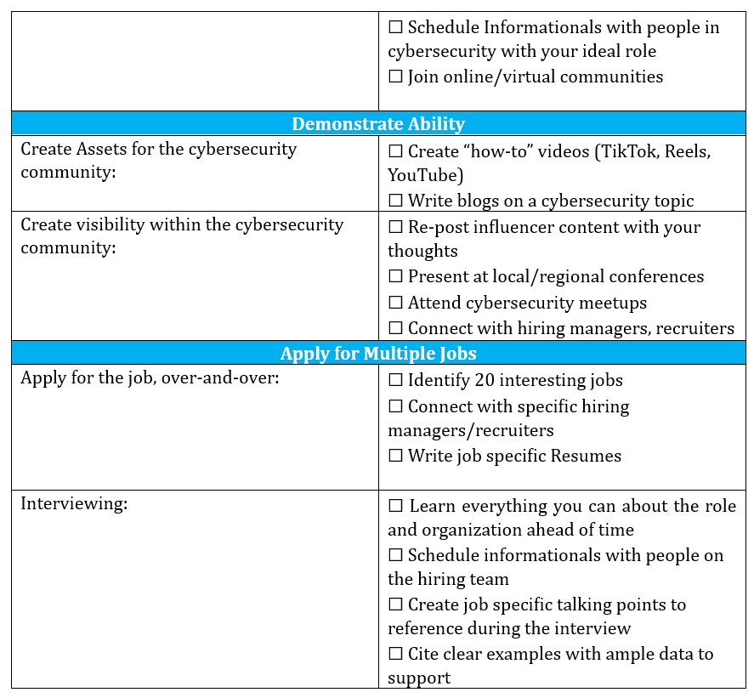
Career Planning Template
https://github.com/joecicero/careercoaching

Slide 18
Tips and Tricks to Shorten the Journey
Develop a Strong Foundation
Pursue Relevant Education and Certifications
Learn About Cybersecurity Fundamentals
Stay Informed
Build Practical Skills
Networking
Create an Online Presence
Specialize
Soft Skills Matter
Apply for Internships and Entry-Level Positions

